Slide 1
RSA Algorithm
Alice want to send her credit card CVV (3 digits) to Bob, she want to make sure that no one can eavesdrop the message.

Slide 2
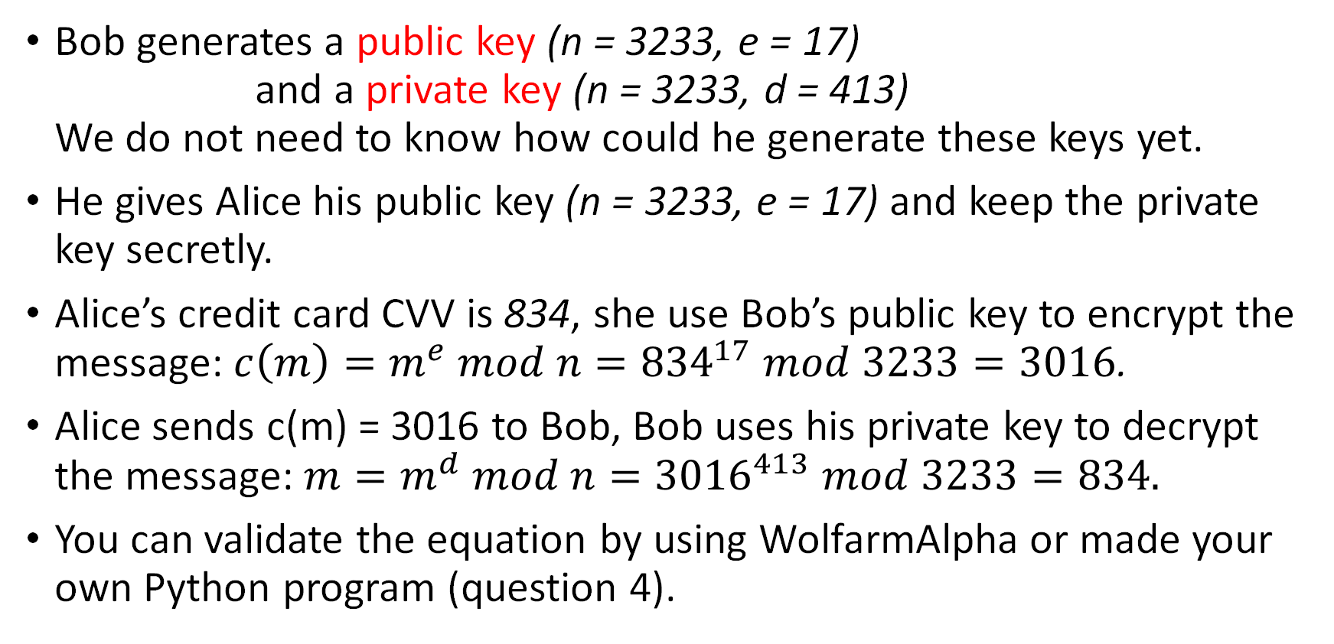
RSA Algorithm
Bob generates a public key (n = 3233, e = 17) and a private key (n = 3233, d = 413) We do not need to know how could he generate these keys yet.
He gives Alice his public key (n = 3233, e = 17) and keep the private key secretly.
Alice’s credit card CVV is 834, she use Bob’s public key to encrypt the message: $c\left(m\right)=m^{e} mod n={834}^{17} mod 3233=3016$.
Alice sends c(m) = 3016 to Bob, Bob uses his private key to decrypt the message: $m=m^{d} mod n={3016}^{413} mod 3233=834.$
You can validate the equation by using WolfarmAlpha or made your own Python program (question 4).

Slide 3


RSA Algorithm
RSA involves a public key and a private key.
A public key can be known to everyone, a public key is used to encrypt the message.
Messages encrypted using the public key can only be decrypted with the private key.
-> This is an asymmetric cryptographic algorithm.
Asymmetric:
Symmetric:

Slide 4
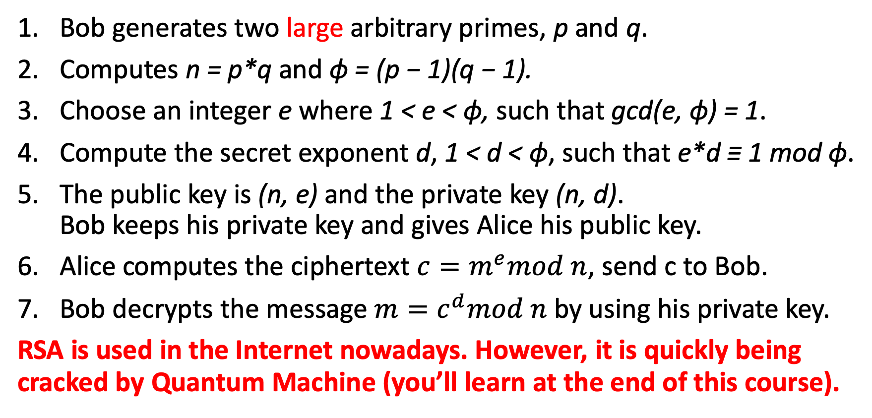
RSA Algorithm (question 4)
public key (n = 3233, e = 17) private key (n = 3233, d = 413)
Bob generates two large arbitrary primes, p and q.
Computes n = p*q and ϕ = (p − 1)(q − 1).
Choose an integer e where 1 < e < ϕ, such that gcd(e, ϕ) = 1.
Compute the secret exponent d, 1 < d < ϕ, such that e*d ≡ 1 mod ϕ.
The public key is (n, e) and the private key (n, d). Bob keeps his private key and gives Alice his public key.
Alice computes the ciphertext $c=m^{e}mod n$, send c to Bob.
Bob decrypts the message $m=c^{d}mod n$ by using his private key.
RSA is used in the Internet nowadays. However, it is quickly being cracked by Quantum Machine (you’ll learn at the end of this course).

